Slide 1
Project Selection

Slide 2
Learning Objectives
Link information systems to business needs
Learn how to create a system request
Understand system feasibility
Learn how to perform a feasibility analysis
Understand how to select a project

Slide 3
Introduction
A project is a set of activities with a specified beginning and end point meant to create a system that brings value to the business
Inception phase: generate a system request based on a business need or opportunity
Perform a feasibility analysis; revise the system request
Approve or decline the project

Slide 4
Project Identification
Projects are driven by business needs
Identified by business people
Identified by IT people
(better yet) identified jointly by business and IT
The project sponsor believes in the system and wants to see it succeed
Normally this is a business person
Should have the authority to move it forward
A higher power sometimes stops projects
Notes:
Give scenarios for authority isn’t there.

Slide 5
Business Value
Tangible Value
Can be quantified and measured directly
Example: 2 percent reduction in operating costs
Intangible Value
We know it will add value & save time, but we may not be able to quantify or measure its benefits
Example: improved customer service, better usability

Slide 6
The System Request
A document that describes the reasons for and the value added from building a new system
Contains 5 elements:
Project sponsor: the primary point of contact for the project
Business need: the reason prompting the project
Business requirements: what the system will do
Business value: how will the organization benefit from the project
Special issues: Anything else that should be considered

Slide 7
Feasibility Analysis (Doesn’t always happen)
Is this project feasible?
What are the risks?
Can these risks be overcome?
Major components:
Technical feasibility (Can we build it?)
Economic feasibility (Should we build it?)
Organizational feasibility (Will they use it?)

Slide 8
Technical Feasibility
Identify risks in the following areas:
The functional area: Are analysts familiar with this portion of the business?
The technology: Less familiarity generates more risk
Project size: Large projects have more risk
Compatibility: Difficult integration increases the risk

Slide 9
Economic Feasibility (Cost-Benefit Analysis)
Identify the costs and the benefits
Assign values to the costs and benefits
Determine the cash flow
Determine the value using one or more methods:
Net present value (NPV)
Return on investment (ROI)
Break-even point

Slide 10
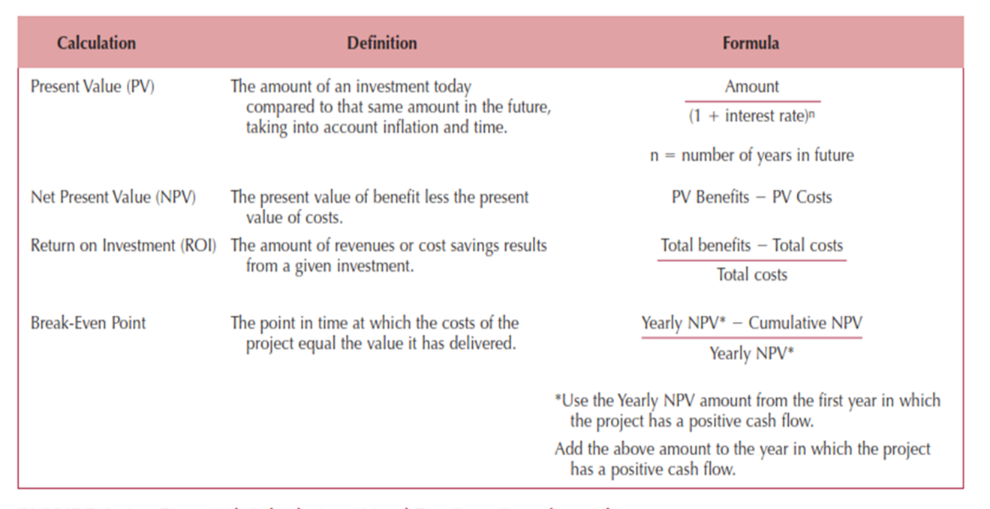
Formulas for Determining Value (Fig 2-7)

Slide 11
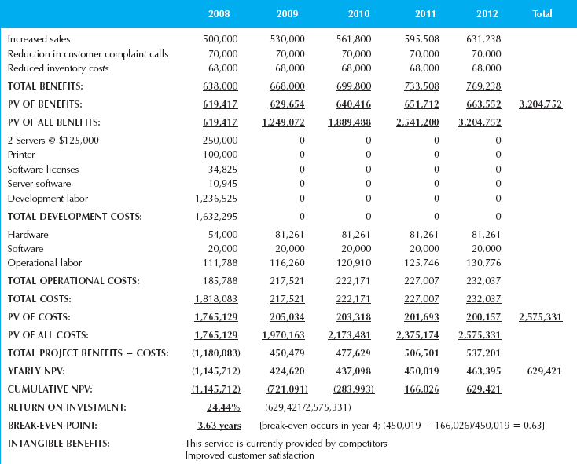
Example Cost-Benefit Analysis (Fig 2-6)

Slide 12
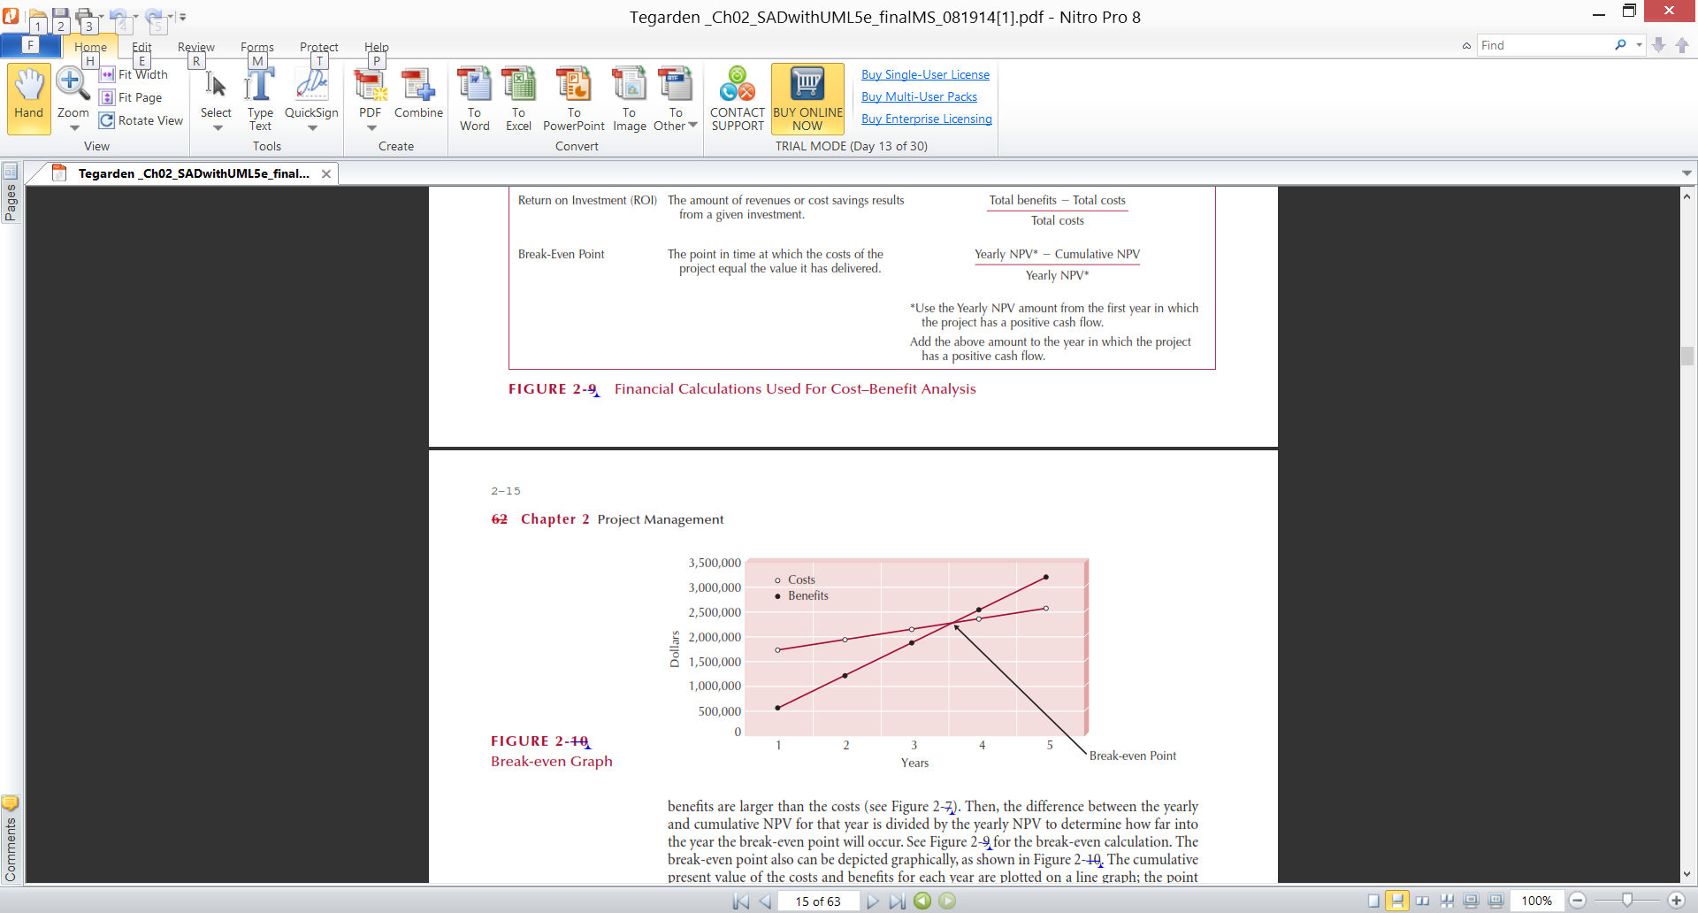
Example Break-Even Point (Fig. 2-8)

Slide 13
Organizational Feasibility
Will the users accept the system?
Is the project strategically aligned with the business?
Conduct a stakeholder analysis
Project champion(s)
Organizational management
System users
Others

Slide 14
Project Selection
Projects are approved, declined or delayed based on value added vs. risks
Project portfolio management
Goals:
Maximize cost/benefit ratio
Maintain an optimal mix of projects based on:
Risk
Size, cost & length of time to complete
Purpose, scope & business value
Limited resources require trade-offs
Selected projects enter the project management process

Slide 15
Summary
Project Initiation
Feasibility Analysis
Project Selection

